Slide 1
Turbine as a Sensor Analytics
Mark Lynass
Scott Evans, Yunwen Xu
Sara Delport, Samuel Davoust
Murray Fisher

Slide 2
Lubbock Analysis

Slide 3
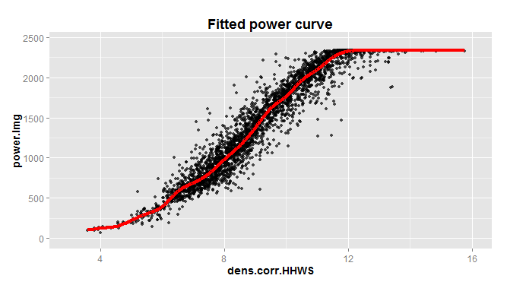
Power Estimation
Variability appears in traditional Power Curve estimation
Power difference
Power.diff = (ActualPower – FittedPower)
Explore the correlation between power deficit ~ shear

Slide 4
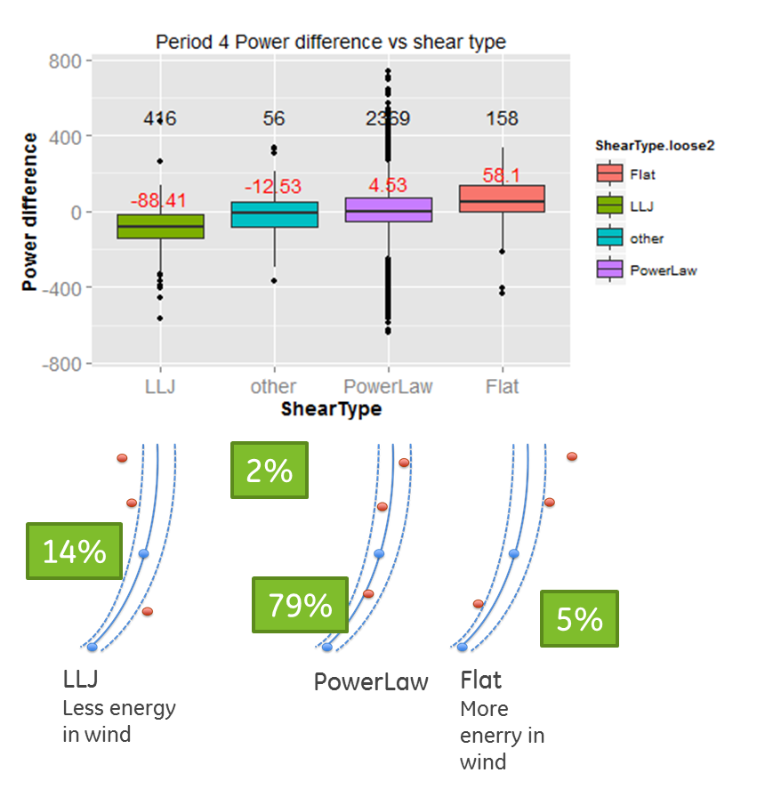
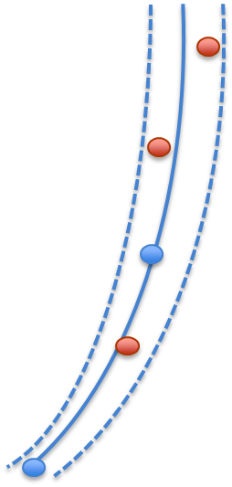
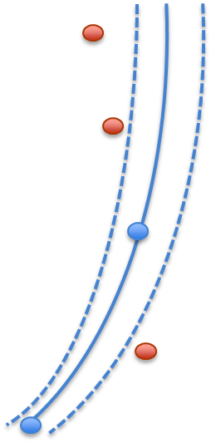
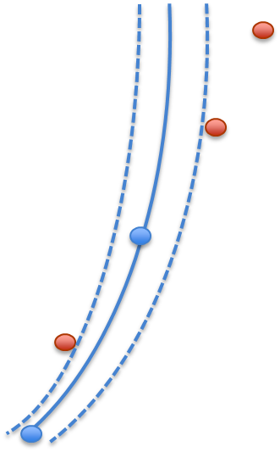
Shear is a Factor
Shear is an important driver of power variation
HHWS only is not sufficient to capture wind speed over vertical range
Power ~ cubic law wrt wind speed
Shear is not commonly used in power estimation
PowerLaw
Normal shear
LowLevelJet (LLJ)
Larger curvature than power law
Flat
Flatter than power law

Slide 5
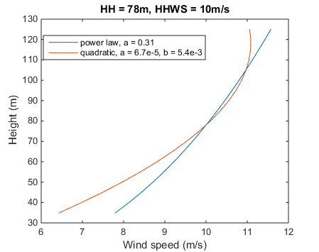
Shear Characterization
PowerLaw
Shear exponent appropriately captures vertical wind speed gradient
LLJ
Shear exponent is not fully capture, need further characterization
Larger curvature than power law
Characterize as quadratic function

Slide 6
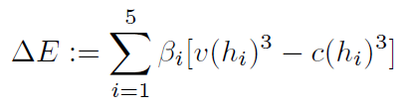
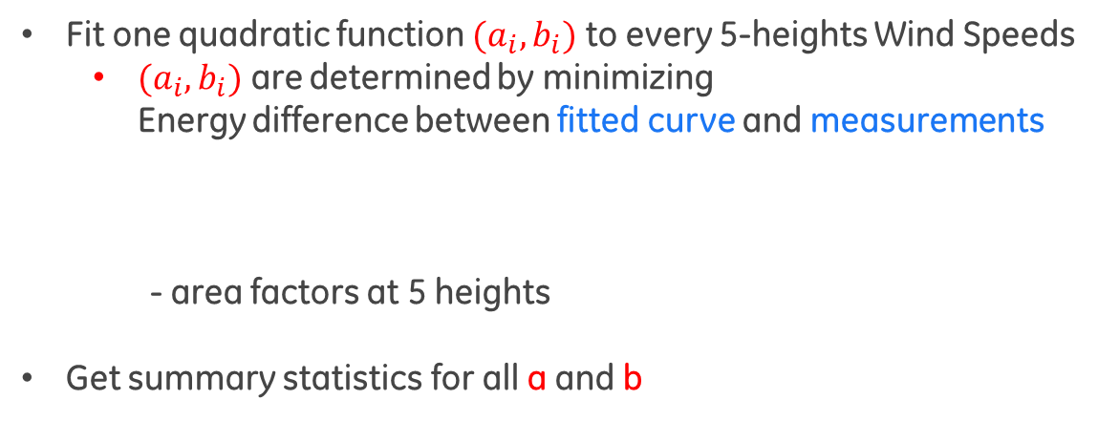
LLJ Characterization - Quadratic Form
Formula
$$v\left(h\right)=v\left(HH\right)\left[a{\left(h−HH\right)}^{2}+b\left(h−HH\right)+1\right]$$
Fit one quadratic function $(a_{i}, b_{i})$ to every 5-heights Wind Speeds
$(a_{i}, b_{i})$ are determined by minimizing Energy difference between fitted curve and measurements
- area factors at 5 heights
Get summary statistics for all a and b

Slide 7
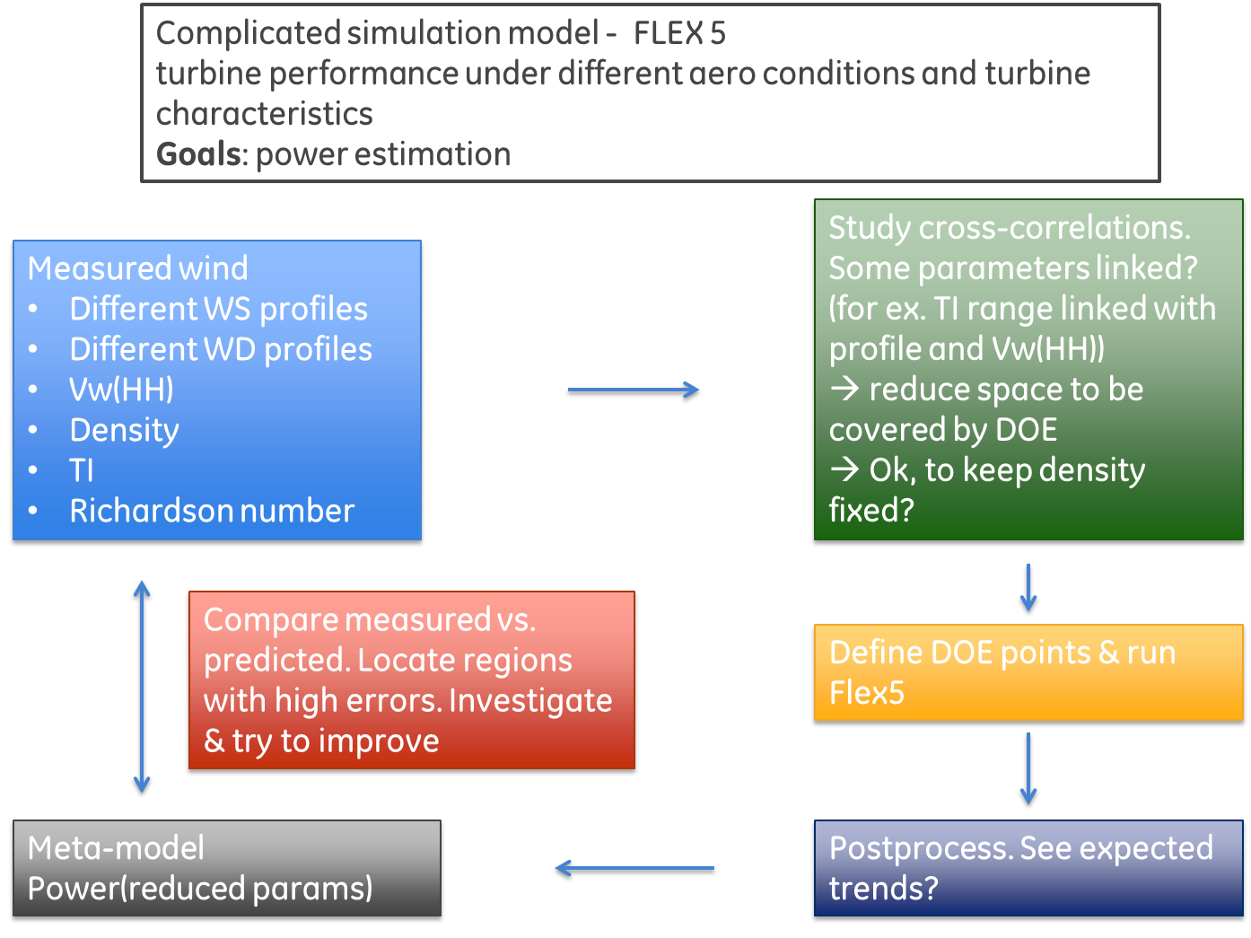
Metamodel for Flex5 -- with Sara Delport, Samuel Davoust, and Murray Fisher

Slide 8
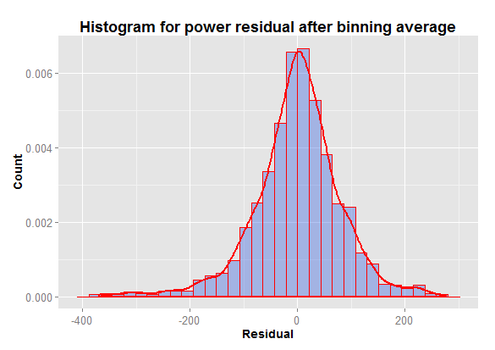
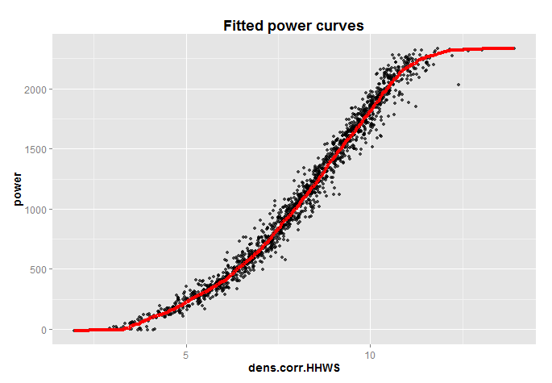
DOE Planning - Wind Speed Interval Approach - Power Decomposition
f-term (main power curve): determined by HHWS Power (v) = mean ( power | if den.corr.HHWS in [v-0.5, v+0.5] )
g-term (residual of main PC): variation caused by other wind conditions
Select data points centered at den.corr.HHWS [v-1, v+1]
Analyze by conditional decision tree
Power = f(den.corr.HHWS) + g(a, b, veer, TI, density)
f(den.corr.HHWS)
Residual
WS window
[7,9]

Slide 9
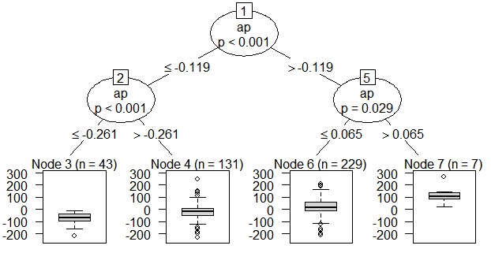
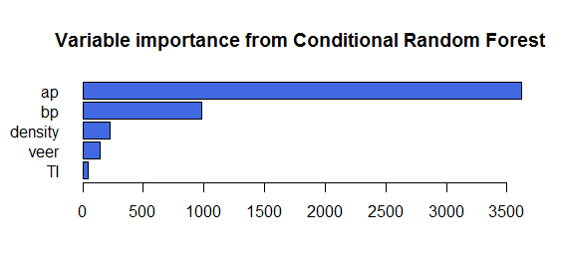
DOE Planning
Power = f(den.corr.HHWS) + g(a, b, veer, TI, density)
DOE matrix
f-term
HHWS = [4, 5, 6, 7, 7.5, 8, 8.5, 9, 9.5, 10, 11, 12]
g-term
Create a decision tree for power variation for data in each WS bin. Generate k input vectors (a, b, density, TI, veer) for each tree
Joint distribution of (a, b)
Sampling veer, density and TI on all terminal nodes
Total # DOE points = #(HHWS) * k
(a, b)
TI, veer, density

Slide 10
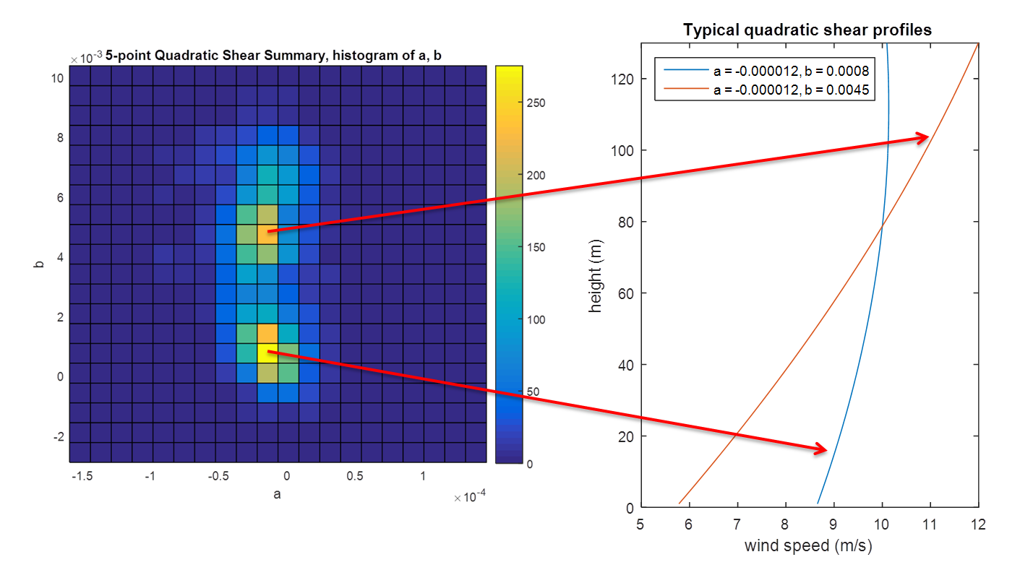
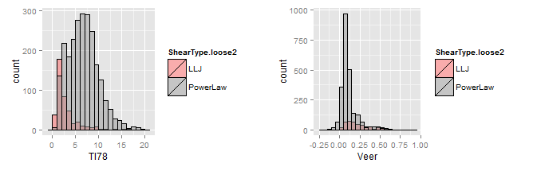
Sample (a, b) based on joint distribution
Sample density, veer and TI from marginal distribution

Slide 11
Neural Network to Reconstruct Power Estimation Relationship in FLEX5
Intelligent Sampling

Slide 12
NN Performance on Field Data

Slide 13
Final Shear Estimation Pitch

Slide 14
Shear Estimation from Turbine Sensors
Scott Evans, Yunwen Xu, Sara Delport
Mark Lynass

Slide 15
Outlines
Observation based on Lubbock 5 speed metmast
Shear type is a driver of power variability
Analysis performed using onboard turbine sensors (e.g. loads)
Shear inference
Opportunities in AEP optimization, lifing, Farm Controls….

Slide 16
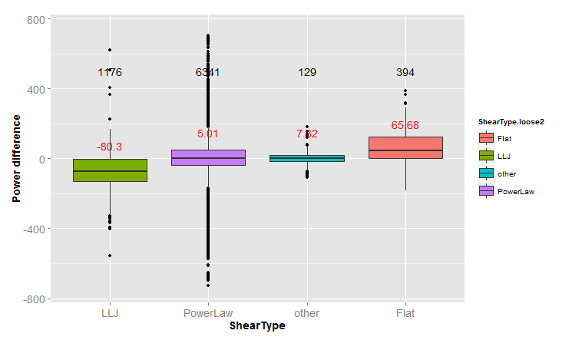
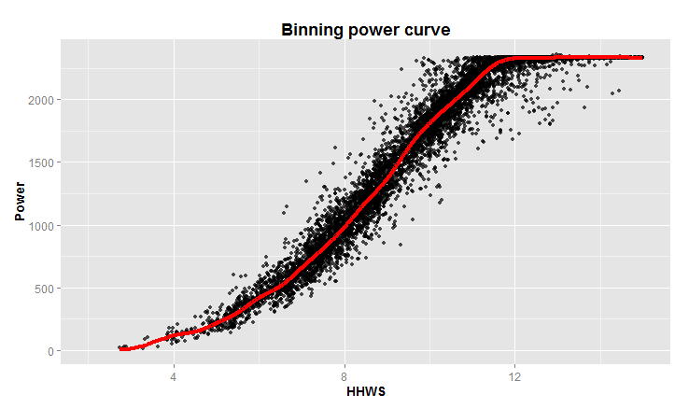
Observation from Lubbock Metmast Analysis
Shear Types
Power differential driven by Shear Type
Low-level-jet ~~ under production
Flat ~~ over production
Type | Power law | Low-level-jet | flat | other
Portion | 79% | 14.5% | 4.5% | 2%
PowerLaw
Normal shear
LowLevelJet (LLJ)
Larger curvature than power law
Flat
Flatter than power law
Power difference

Slide 17
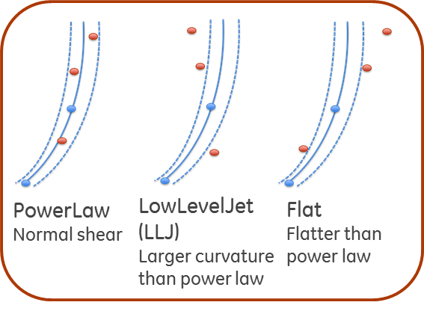
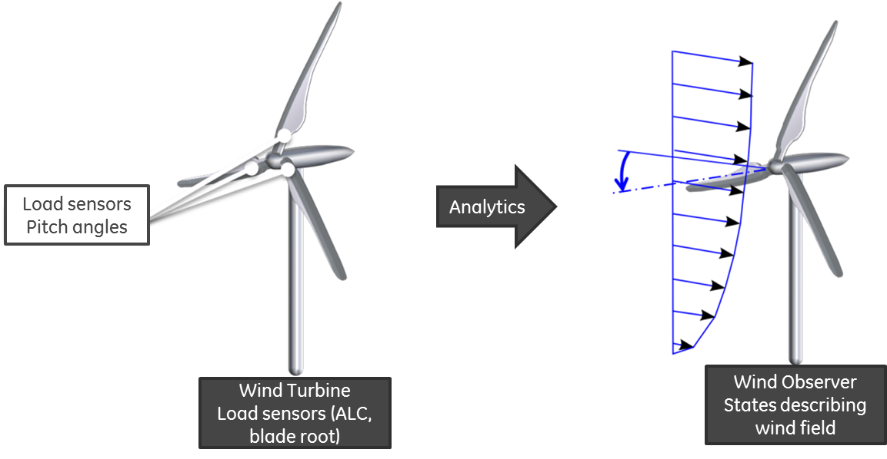
Classification Formulation
Motivation
Shear profile is a main driver for power performance
Every two classes are statistically different (except power law vs. other)
Can we identify the classes (especially LLJ) from load sensor signals?
Statement and objective
Use load sensors signal to predict wind shear profiles
Low Level Jet < Power Law < Flat
X
Nodd
Pitch
Yaw
RPM
P_el
MBC V_estim
Y
(Class label)
PowerLaw
LLJ
Flat
After Classified, We will infer Shear Parameter(s)

Slide 18
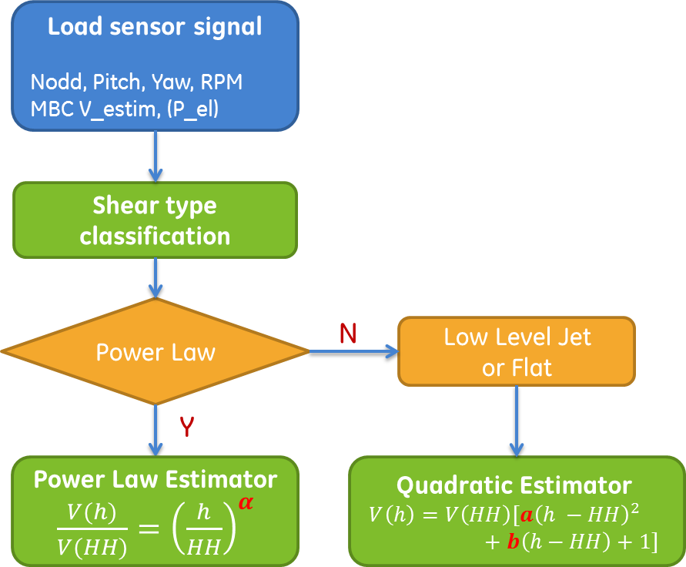
Shear Estimation Process
Inputs
ML algorithm

Slide 19
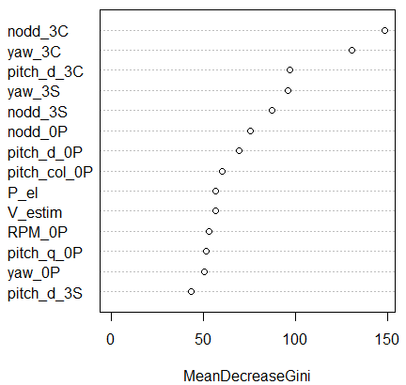
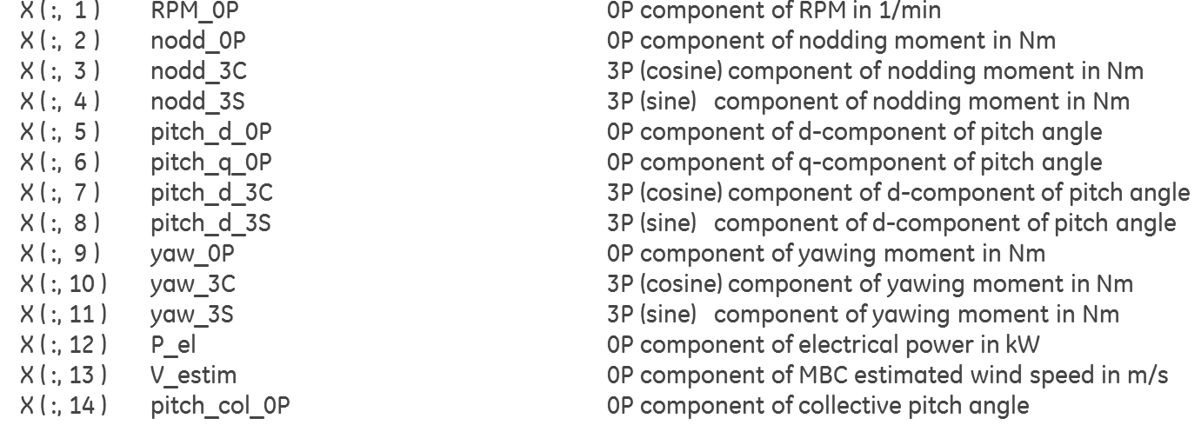
Input Signal from Load Sensors
Variable importance
Turbine sensor signal used to classify Shear Type and Infer Shear Parameters
Most important Features are nodding 3C and Yaw 3C Components
2 min averaged signal
X: Available from load sensors

Slide 20
Shear Estimation - Random Forest
Shear Type Classification Result

Slide 21
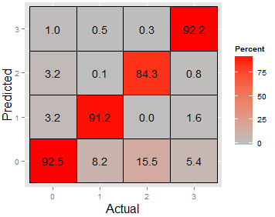
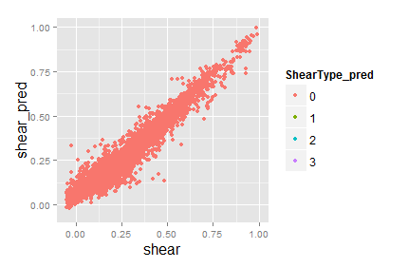
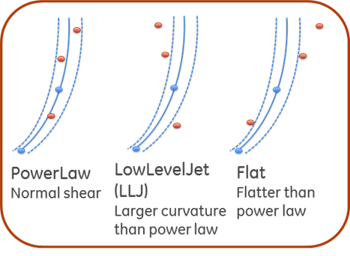
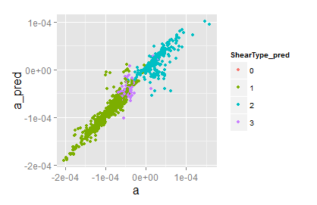
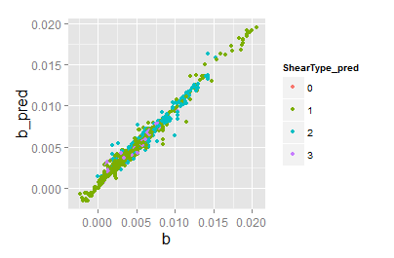
Performance Summary - Random Forest
Shear Type classification
Alpha estimation
Confusion matrix
Overall accuracy = 91.9%
0: Power Law
1: Low Level Jet
2: Other
3: Flat
7.5% misclassification
MAE = 0.031
A estimation
B estimation
MAE = 7.2e-6
MAE = 3.2e-4

Slide 22
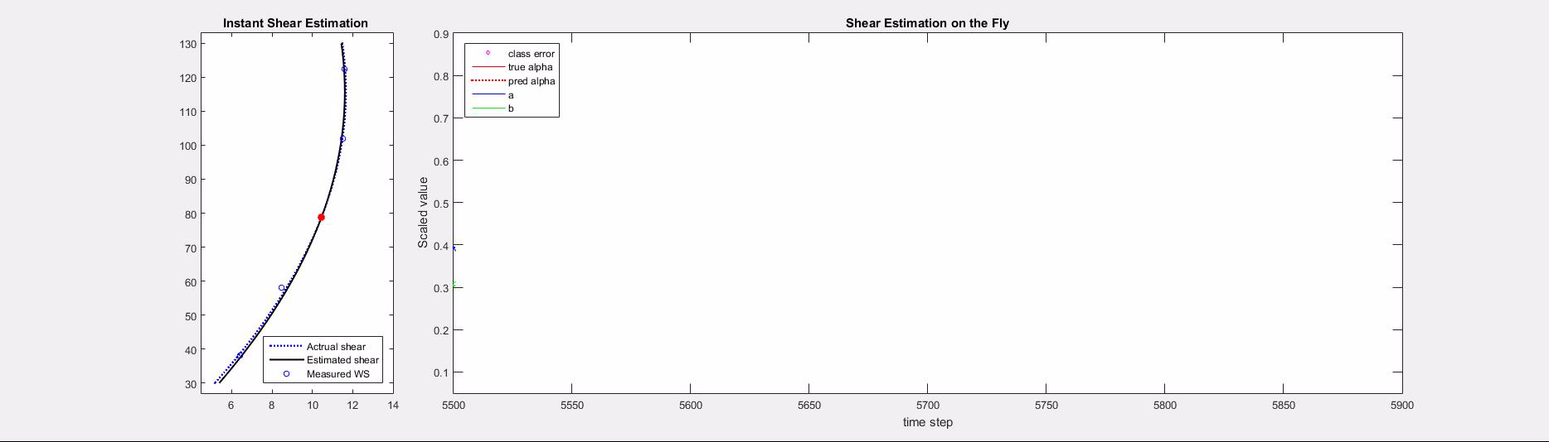
Shear Estimation in Streaming

